Slide 1
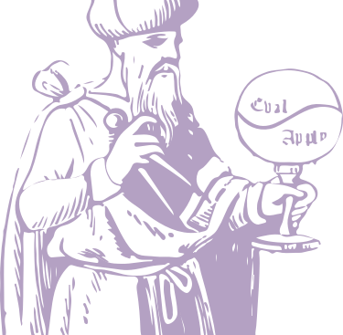
Pragmatic Functional Programming
Using Dyalog
Morten Kromberg
CTO, Dyalog Ltd
Functional Conference 2014 Bangalore

Slide 2
Edsger Dijkstra on APL
APL is a mistake, carried through to perfection.
It is the language of the future for the programming techniques of the past.
It creates a new generation of coding bums.
But see for example: http://archive.vector.org.uk/art10501260 http://www.zdnet.com/blog/murphy/apl-cobol-and-dijkstra/568

Slide 3
Edsger Dijkstra on APL
APL is a mistake, carried through to perfection.
It is the language of the future for the programming techniques of the past.
It creates a new generation of coding bums.

Slide 4
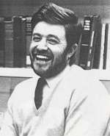
History of APL
Canadian of Norwegian Descent
Born on a small farm in Alberta
Finished one-room school after 9th grade and worked on the farm
Drafted by army in 1942; Flight Engineer in Air Force from 1943
Almost finished High School in the service
Enjoyed teaching his service mates mathematics
Promised his officers and mates that he would pursue an academic career after the war
B.A. from Queens University, Kingston Ontario, in 1950 – top of his class.
Ken didn’t know there was such a thing as University before he joined the army!
Kenneth E. Iverson 1920-2004

Slide 5
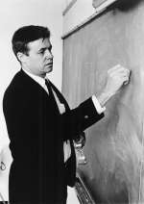
History of APL, continued
Doctoral work at Harvard with Aiken and Leontief (latter later Nobel Economics Laureate)
Leontiefs input/output model required matrix math
Taught mathematics at Harvard for 6 years, getting frustrated with inadequacies of the notation
Developed ”Iverson Notation” in response
Failed to get tenure at Harvard; moved to IBM
Published ”A Programming Language” in 1962
Used APL for modelling and teaching
First APL Interpreter in 1966
IBM Fellow in 1970
J (”rationalised APL”) from ca. 1989
ACM Turing award in 1979:
“For his pioneering effort in programming languages and mathematical notation resulting in what the
computing field now knows as APL, for his contributions to the implementation of interactive systems, to educational uses of APL, and to programming language theory and practice.”

Slide 6

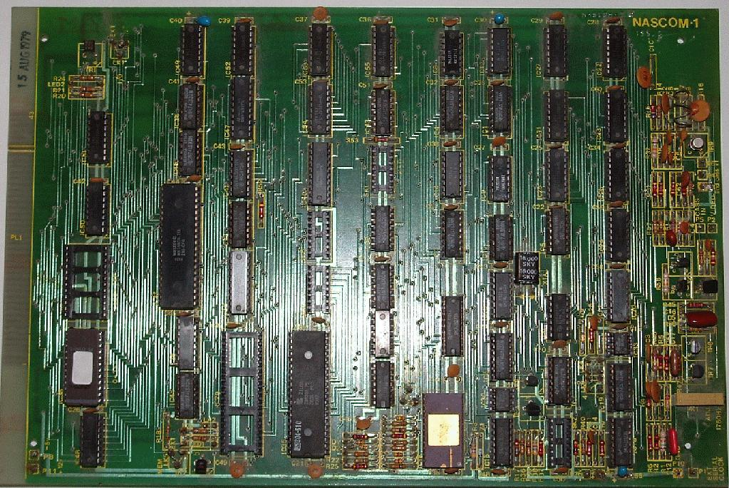
History of Morten
Norwegian South African living in DK, working in UK
Born as A Programming Language published (1962)
Learned BASIC and 6502 & Z80 machine code in 1977, built a NASCOM 1 (which almost worked)
Met APL in 1979; since then:
Wrote at least one program and made it run in each of ASM C C# COBOL Java JCL Pascal Prolog Simula
Eventually discovered it would be easier to hire people with degrees rather than do the hard work himself
15 years as APL consultant and part-time MVS systems programmer
CTO of BI ”startup” Adaytum; sold to Cognos for $165M in 2000
CTO of Dyalog since 2005; vendor of APL

Slide 7

History of Dyalog
Youngest APL Vendor – version 1.0 released in 1983 as a UNIX-based competitor for mainframe APL
Version 14.0 for Microsoft Windows, Intel and ARM Linux (Raspberry Pi) and IBM AIX released in June
Mac OSX support announced for v14.1 (”Q1 2015”)
Slow growth for 25 years; rapid growth since 2005
From ”new kid on the block” to market leader in a mere 35 years; investing heavily in APL technology
Current revenue split roughly evenly between UNIX and Windows, USA and ”ROW”
80% of revenue from software houses that build products in APL, remainder ”in house” analytics
20 heads, of which 15 engineers working on APL

Slide 8











Syntaxes of Mathematics
Problems:
- Wide variety of syntactical forms
- Strange and inconsistent precedence rules - Things get worse when you deal with matrices See http://www.jsoftware.com/papers/EvalOrder.htm

Slide 9
Syntaxes of APL
Syntactical Form | Example | Result
function argument | ⍳ 6 | 1 2 3 4 5 6
left_arg function right_arg | 1 2 3 × 1 10 100 | 1 20 300
operand operator argument | ×/ 1 2 3 4 5 6 | 720
larg left-op operator right-op rarg | 1 0 2 +.× 1 2 3 | 7
array[index] | 'ABCDEF'[2 5 5 6] | BEEF
Naming | Usage | Result
data←1 2 3 | data | 1 2 3
sum←+/ | sum 1 2 3 | 6
vprod←+.× | 1 2 vprod 3 4 | 11
reduce←/ | × reduce 1 2 3 4 | 24

Slide 10
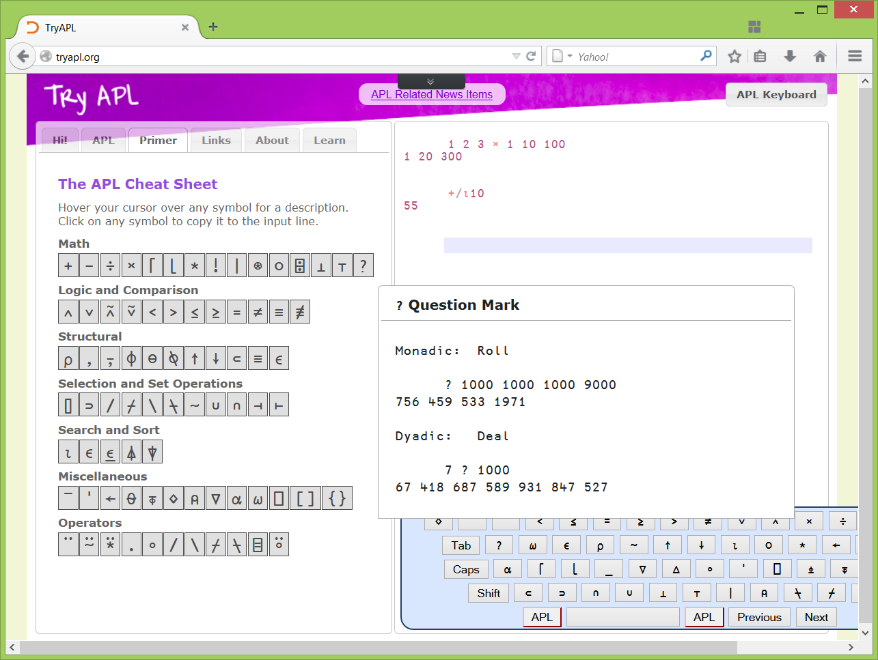
Primitive Functions
TryAPL screen shots (or live demo)
Notes:
Hover over one member and talk about each group of functions, and talk about operators

Slide 11
A Programming Language (for Mathematics)
a×b
Mat1 +.× Mat2
*x
f g x
(f+g) x
x÷y
(3○x)*2
b⍟a
+/4×⍳6 ×/4×⍳6
a*÷n
(2×a)÷⍨(-b)(+,-)0.5*⍨(b*2)-4×a×c

Slide 12
APL Fundamentals
Only one data type: The “Immutable*” Array
Each item is a number (from boolean to complex), a (Unicode) character, or a (nested) array
NB: A single number is a zero-dimensional array
For most primitive functions, map is implicit
All functions are prefix (÷6) or infix (3×4)
Operators are postfix (+/) or infix (+.×)
Order of execution is as in f g x
Right argument to any function is the result of evaluating the entire expression to the right
AKA “Right to left”
*If you stay away from “object references” ☹
Notes:
”Immutable” is a difficult term for me

Slide 13
Demo #1 – Introducing APL
Notes:
”Immutable” is a difficult term for me

Slide 14
Execute Right to Left, but Read Left to Right
(2×a)÷⍨(-b)(+,-)0.5*⍨(b*2)-4×a×c
“2 times a divided into minus b plus or minus the square root of the discriminant, b squared minus 4 a c.”
(an APL expression which cannot be understood when read left to right should probably be broken up)

Slide 15
“Functional” since 1962
John Backus’ Turing Award Lecture (1977):
We owe a great debt to Kenneth Iverson for showing us that there are programs that are neither word-at-a-time nor dependent on lambda expressions, and for introducing us to the use of new functional forms.

Slide 16
In ‘77, Backus did go on to say…
Unfortunately, APL still splits programming into a world of expressions and a world of statements. APL has exactly three functional forms, called inner product, outer product, and reduction*.
APL semantics is still too closely coupled to states. Consequently, despite the greater simplicity and power of the language, its framework has the complexity and rigidity characteristic of von Neumann languages.
* There were actually four, Backus missed “scan”

Slide 17
Dyalog (APL) in 2014
“Dyalog is a modern, array-first, multi-paradigm programming language, which supports functional, object-oriented and imperative programming based on an APL language kernel.”

Slide 18
Common Functional Forms … Translated to APL
Scheme | APL | Comment
(map f a) | f a | For scalar functions like +-×÷* (and many others), map is implicit
(map f a) | f¨ a | Each (¨) is an explicit map (required to map non-scalar functions)
(filter f a) | (f a)/a | Compress (/) uses boolean array on left to select items
(fold-right f x a) | f/a | Reduction (when the left operand of / is a function). APL sets the initial value to the identity element , eg. 0 for +, 1 for ×

Slide 19
cons, car and cdr
Scheme | APL | Comment
(cons x y) | x y x,y | Juxtaposition creates lists (”vectors”) from scalars. For higher ranks, use catenate (,)
(car a) | ⊃a | Take is n↑a
(cdr a) | 1↓a | You can drop any number of items

Slide 20
Vector and Matrix Products
General Vector Inner Product (map / reduce)
Scheme: (fold-right f 0 (map g vector1 vector2))
APL: vector1 f.g vector2 // ⍺ f.g ⍵ ←→ f/ ⍺ g ⍵ NB: +.× is not only useful case. Popular examples: ∧.=, ∨.=, ∨.∧
Matrix Multiplication
Scheme: (define (matrix-multiply matrix1 matrix2) (map (lambda (row) (apply map (lambda column (apply + (map * row column))) matrix2)) matrix1))
APL: matrix1 +.× matrix2 // rows of ⍺, cols of ⍵

Slide 21
Outer (Cartesian) Product
Outer or Cartesian Product
Scheme: (define (outer-product f a b) (map (lambda (x) (map (lambda (y) (f x y)) > b)) a))
APL: x ∘.f y
Example: Maximum Table
∘.⌈ ⍨ ⍳6 // ⍨ is ”selfie”: f⍨x ←→ x f x 1 2 3 4 5 6 2 2 3 4 5 6 3 3 3 4 5 6 4 4 4 4 5 6 5 5 5 5 5 6 6 6 6 6 6 6
⍺>⍵

Slide 22
Other Dyalog Operators
Form | Example | Comment
f \ | ×\1 2 3 4 | 1 2 6 24 // Scan (forgotten by Backus)
f ⍨ | 2 ÷⍨ 1 | 0.5 // Commute: ÷⍨ is ”divide into”
f ⍣ n | {0.5×⍵}⍣3 | Power: Apply function (halve) three times
f ⍣ g | {1+÷⍵}⍣≡1 1.618033989 | Apply until (f⍣(n-1))g(f⍣n) returns 1 (true) (Computes the ”golden ratio”/Phi)
f ⍤ n | ,⍤2 | Rank: Apply f to sub-arrays of specified ranks Example combines last 2 dimensions into one
f ⌸ | keys{+/⍵}⌸ x | Key: Similar to SQL GROUP BY; applies f to groups of items corresponding to each unique key value.
f ∥ |  | Parallel: Experimental in Dyalog v14.0: Derives asynchronous function which immediately returns a future: Futures block when value is required.

Slide 23
“Point-Free” Forms
Form | Examples | Comment
(f g h) | (f + g) y mean←+⌿ ÷ ≢ | Fork: (f g h) ⍵ ←→ (f ⍵) g (h ⍵) …or… ⍺ (f g h) ⍵ ←→ (⍺ f ⍵) g (⍺ h ⍵)
(g h) | intdiv←⌊÷ | Atop: (g h) ⍵ ←→ g h ⍵ …or… ⍺ (g h) ⍵ ←→ g (⍺ h ⍵)
x∘f f∘y | a32 ←32∘+ scale←×∘1.8 | Composition: (⍺∘g) ⍵ ←→ ⍺ g ⍵ (g∘⍵) ⍺ ←→ ⍺ g ⍵
f∘g | f←a32∘scale | Composition: f∘g ⍵ ←→ f g ⍵ ⍺ f∘g ⍵ ←→ ⍺ f g ⍵
Currying Infix Operator
Form | Examples | Comment
(inop g) | fixpoint ← ⍣ ≡ inverse ← ⍣ ¯1 | f (dop g) ←→ f dop g

Slide 24
Look Ma, No Loops!
The fact that map is implicit, and indexing can be done using arrays, encourages ”switch free” logic. Your data structure acts as a ”control structure”:
Example | Comments
data←2 7 15 60 data ⌈ 5 5 7 15 60 | if data[i]>5 then data[i] else 5
data + 1 × data ∊ 3 7 15 2 8 16 60 | Conditional increment
(x×flags) + y×~flags | If flags[i] then x else y
ages←'child' 'young' '20s' 'old' ages[1⌈4⌊data(⌈÷)10] child child young old | “bucketing”
NB: This stuff is *really* easy for a compiler to parallelise

Slide 25
User-Defined Fns and Ops
Examples | Comment
avg←{(+⌿⍵)÷≢⍵} avg 1 2 3 4 2.5 | Prefix function if only ⍵ (right argument) referenced
plusdouble←{⍺+2×⍵} 1 2 plusdouble 3 4 7 10 | Infix function if ⍺ (left argument) is used
inverse←{(⍺⍺ ⍣ ¯1) ⍵} CtoF←(32∘+)∘(×∘1.8) CtoF inverse 32 212 0 100 | Postfix operator: if only ⍺⍺ (left operand) is referenced.
redscan←{⍺⍺ / ⍵⍵ \ ⍵} (+ redscan ×) 1 2 3 9 | Infix operator: if ⍵⍵ (right operand) is used.

Slide 26
User-Defined Fns and Ops
Multi-line recursive function | Comment
fibonacci←{ ⍺←0 1 ⍵=0:⊃⍺ (1↓⍺,+/⍺) ∇ ⍵-1 } | Tail calls: *are* optimised Default value for left argument Guard: Return head ⍺ if ⍵=0 Recursion: ∇ is self
fibonacci¨ ⍳10 1 1 2 3 5 8 13 21 34 55 | Example of application

Slide 27
Demo #2 – Using APL

Slide 28
Some Major Customers
SimCorp (DK), APL Italiana (I), Fiserv Investment Services (US), Infostroy Ltd (Russia)
Leaders in various markets for Asset Management Systems
KCI Corp (US)
Budgeting and Planning
Carlisle Group (US)
Collateral and Securitization for Global Capital Markets
CompuGroup Medical / TakeCare (Sweden)
Worlds largest Electronic Patient Journal system with 40,000 users and several million patient records in Sweden
A Major US Oil Company
Optimizes the “Cracking” of Petroluem Products using APL

Slide 29
A Recent Application
Stormwind Simulator Winner of “Apps4Finland” 2013
http://www.youtube.com/watch?v=yuxfKzSiRF8

Slide 30
Where have we been?
The most successful APL developers are “any kind of engineer other than a software engineer”.
They do not feel comfortable at events like this one
They generally hate software fashion waves
It took 10 years to discover that the PC was here to stay, most APL vendors suffered immensely when personal computing left the mainframe
This was immediately followed by the Dark Ages of OO C++ madness and GUI API insanity.
Fortunately this WAS temporary.
Focus on arrays and functional programming gives us courage to come out of our holes again…
FP took 80 years to catch on, OO 20, we’re now 50

Slide 31
To Successfully Use APL…
Get the right mix of domain experts and software engineers
Be pragmatic: Stay functional where you can
Use objects and mute state when you must
Languages like APL will be the solution to the next BIG problem after concurrency:
complexity

Slide 32
“The only program which stands a chance of being correct is a short one.”
(Arthur Whitney, inventor of the K language)

Slide 33
Dyalog vs Backus ‘77
Now more than a dozen primitive functional forms, plus user-defined higher order functions.
Functions are still not quite “first class”
But the infix function/operator syntax combo is very natural to work with when creating internal DSLs: Adding first class functions could “break” the language
It is still possible (and often attractive, especially when modelling) to create stateful APL programs
Dyalog APL encourages “pure” functional programming
Spend as much time as possible within the “Circle of Purity”

Slide 34
Major Language Extensions Since IBM APL2 (1984)
1995: Control structures (if/then/else) adopted by several vendors including Dyalog.
1996: Optional lexical scope and lambda expressions in APL (“dfns” – Dyalog APL).
2006: Object orientation (Dyalog, MicroAPL, VisualAPL).
2014: Point-free or “tacit” syntax (from J) adopted by first APL vendor (Dyalog).
2014: Futures and isolates for parallel programming (Dyalog).

Slide 35
Work yet to do after 50 years
(Parallelising) Compilers
Real ”Types” in the language (a challenge!)
Better Libraries for Application Development
Closures
Rational Numbers / Unlimited Integers
Lazy Evaluation

Slide 36
How to get hold of it?
http://tryapl.org (online REPL)
https://www.youtube.com/user/DyalogLtd (videos)
http://video.dyalog.com (more videos)
http://dyalog.com/download-zone.htm
Free for students, and NB: http://dyalog.com/student-competition.htm
Low cost non-commercial version
Special offer this week: Register that you are a FuConf delegate and ignore automated payment instructions

Slide 37
Many Thanks To
Brian Becker
For help with the ”Tag Cloud” example
Nick Nickolov for feedback
Scheme examples
Roger Hui for much feedback
Co-authoring the ”friend” functions
Co-inventing many functional extensions in J, together with Ken Iverson
John Scholes for constructive feedback
Inventing the ”dfns” functional form
Tomas Gustafsson (StormWind)
For his amazing application and video handmade for today
You All for listening!

Slide 38
Any Questions
?
Prefix: Roll (scalar) - Integer in range 1 to ⍵: ? 6 6 6 6 4 3 4 2
Infix: Deal – deal ⍺ items from range 1 to ⍵: 5?6 2 5 1 4 6
Selfie: Permutation: ?⍨6 3 1 4 2 6 5

